Slide 1
John Lewis Invictus Academy Budget Feedback Meeting

Slide 2
Norms
This is a meeting of the GO Team. Only members of the team may participate in the discussion. Any members of the public present are here to quietly observe.
We will follow the agenda as noticed to the public and stay on task.
We invite and welcome contributions of every member and listen to each other.
We will respect all ideas and assume good intentions.

Slide 3
GO Team Budget Development Process
YOUR SCHOOL STRATEGIC PLAN…
is your roadmap and your role.
It is your direction, your priorities, your vision, your present, your future.
Step 1: Data Review
Step 2: Strategic Plan Review
Step 3: Budget Parameters
(Strategic Priorities)
Step 4: Budget Choices
Notes:
Today I will provide an overview of the budget allocations for FY23. We will begin the work of funding the strategic priorities we agreed upon during our strategic review meeting. (IF YOU HAVE NOT DECIDED ON YOUR PRIORITIES, YOU WILL SAY – WE WILL DECIDE ON OUR PRIORITIES AND THEN DISCUSS ALLOCATING FUNDS TO ADDRESS THOSE PRIORITIES).

Slide 4
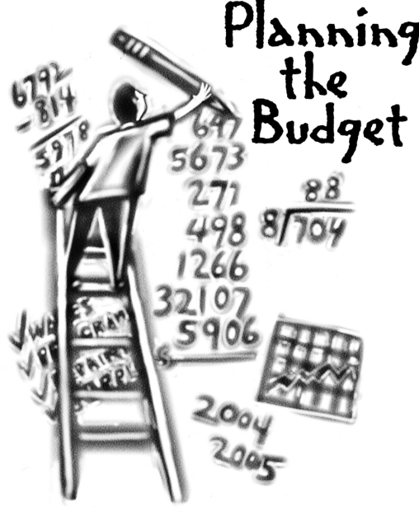
Overview of FY ‘25 GO Team Budget Process
Step 2 Principals: Workshop FY 25 Budget
January 17
Step 4 Principals: Associate Supt. Discussions and Review
February (supports needed, specific challenges, coaching)
Step 1 Review and Update Strategic Plan
Step 6 Principals: HR Staffing Conferences Begin
Late February – Early March
Step 3 GO Team Initial Budget Session
January 17 – early February
Step 7 GO Team Final Budget Approval Meeting
Budgets Approved by March 15
Step 5 GO Team Feedback Session
February – ongoing if necessary
GO Teams are encouraged to have ongoing conversations

Slide 5
Budget Feedback Meeting
What
The GO Team feedback session(s) should be scheduled for the principal to provide an overview of the school’s draft budget for the GO Team members and the general public.
Why
This meeting provides an opportunity for GO Teams to discuss how the school’s budget has been allocated to support the programmatic needs and key strategic priorities.
When
Meetings must be held in February before staffing conferences. May be combined with the allocation meeting (as needed), if the GO Team has completed strategic plan updates and ranked strategic priorities.
Notes:
Looking for general consensus prior to Staffing Conferences

Slide 6
John Lewis Invictus Academy
Strategic Plan
Strategic Plan Priority Ranking
1. Create a culture of high expectations for academic scholarship, civic
responsibility, and service for students, staff, and families.
2. Prepare and develop knowledgeable staff focused on quality teaching.
3. Close the student achievement gap with general education and students with disabilities.
4. Implement STEAM-enriched curriculum to drive interdisciplinary and project-based teaching
and learning approaches.
5. Prepare all students to have the essential life skills to be self-aware, collaborative, and
accepting of diversity.
6. Ensure systems and resources are aligned with school priorities
7. Build systems and resources to support STEAM implementation.
Higher
Lower

Slide 7
FY25 Budget Parameters
FY25 School Priorities | Rationale
1. Create a culture of high expectations for academic scholarship, civic responsibility, and service for students, staff, and families. | A culture of high expectations will support improved student outcomes
2. Prepare and develop all teachers to be knowledgeable in their content area. | Building teacher capacity in their content area fosters the opportunity for students to engage in rigorous and relevant learning experiences.
3. Improve students’ mastery of core content knowledge (ELA, Math, Science, Social Studies. | Increasing student achievement will ensure students are prepared for high school and post secondary options.
Notes:
Review the priorities that the GO Team has developed and the rationale for these priorities. Feel free to copy this slide if you have more than 3 priorities to account for.

Slide 8
FY25 Budget Parameters
FY25 School Priorities | Rationale
4. Close the student achievement gap with general education and students with disabilities. | A focus on subgroups ensures all students are a part of the instructional planning process.
5. Implement STEAM-enriched curriculum to drive interdisciplinary and project-based teaching and learning approaches. | Interdisciplinary teaching provides opportunities for students to develop a deeper understanding of content.
6. Prepare all students to have the essential life skills to be self-aware, collaborative, and accepting of diversity. | An intentional focus on developing social skills is critical to middle school learns.
7. Ensure systems and resources are aligned with school priorities | Ensuring systems and recourses are aligned with priorities optimizes human and financial capital.
Notes:
Review the priorities that the GO Team has developed and the rationale for these priorities.

Slide 9
Descriptions of Strategic Plan
Breakout Categories
Priorities: FY25 funding priorities from the school’s strategic plan, ranked by the order of importance.
APS Five Focus Area: What part of the APS Five is the priority aligned to?
Strategies: Lays out specific objectives for school’s improvement.
Request: “The Ask” What needs to be funded in order to support the strategy?
Amount: What is the cost associated with the Request?

Slide 10
FY25 Strategic Plan Break-out
Priorities | APS FIVE Focus Area | Strategies | Requests | Amount
1. Create a culture of high expectations for academic scholarship, civic responsibility, and service for students, staff, and families. | Building a Culture of Student Support | 1. Common structures and strategies 2. Beliefs and mindsets 3. Scholar expectations 4. Faculty/Staff Expectations 5. Implement a schoolwide behavior plan | Supplies and Student Incentives Behavior Specialist | $50, 000 $104, 418
2. Prepare and develop all teachers to be knowledgeable in their content area. | Equipping & Empowering Leaders and Staff | 1.Provide targeted professional learning opportunities focused on the implementation of standards. 2.Implement intentional vertical and horizontal alignment collaboration through the school and cluster. 3.Provide targeted professional learning regarding standard-based instruction opportunities focused on Mathematics and Reading through our partnership. 4.Increase reading, math, and science endorsements and certifications. 5.Leverage professional references of applicants. 6.Look at previous student performance data, if applicable. | Instructional Coaches (3) | $391,016
Notes:
For the next few slides, I will show you how I have allocated the budget to support our strategic priorities.
Based on our strategic priorities and funds we received, here is a break-out of the priorities, which focus area it addresses, the strategies that will be implemented, the purchase request, which funding source was used and the amount.

Slide 11
FY25 Strategic Plan Break-out
Priorities | APS FIVE Focus Area | Strategies | Requests | Amount
3. Improve students’ mastery of core content knowledge (ELA, Math, Science, Social Studies. | Fostering Academic Excellence for All | 1A. Implement standards-based strategies. 1B. Build teacher capacity around instructional best practices through collaborative planning and the coaching cycle. 1C. Provide remediation and acceleration as indicated by data. 2A. Implement data talks to increase math and reading fluency. 2B. Use flexible learning days to remediate/ accelerate skills based on grade-level data to guide instructional practices. 2C. Implement guided reading and close reading to improve comprehension. 3A. Provide targeted professional learning opportunities focused on implementing standards and STEAM. 3B. Implement integrated, project and problem-based learning projects. 3C. Integrate technology throughout the curriculum. 4A. Implement Social Emotional Learning (SEL). 4B. Implement rigorous and real-world interdisciplinary projects and units. 4C. Execute a plan to increase the speaking, listening, and viewing skills of all students at grade level. | Two Content Teachers Per Grade Level (ELA, SS, Math, Science) Web-based Subscriptions and Licenses | $3,224,582 $31,225
4. Close the student achievement gap with general education and students with disabilities. | Fostering Academic Excellence for All |  | Engagement Specialist | $124, 059
5. Implement STEAM-enriched curriculum to drive interdisciplinary and project-based teaching and learning approaches. | Fostering Academic Excellence for All |  | Signature Instructional Coach Fine Arts Teachers
6. Prepare all students to have the essential life skills to be self-aware, collaborative, and accepting of diversity. | Fostering Academic Excellence for All |  | One Counselor Per Grade Level
Notes:
For the next few slides, I will show you how I have allocated the budget to support our strategic priorities.
Based on our strategic priorities and funds we received, here is a break-out of the priorities, which focus area it addresses, the strategies that will be implemented, the purchase request, which funding source was used and the amount.

Slide 12
FY25 Strategic Plan Break-out
Priorities | APS FIVE Focus Area | Strategies | Requests | Amount
7. Ensure systems and resources are aligned with school priorities | Creating a System of School Support | 1.Build and align systems and resources to identify and address root causes to promote social and academic growth. 2.Ensure the necessary technology infrastructure and equipment are available. 3.Use the Care Center at John Lewis Invictus Academy to promote healthy living and increase attendance. 4.Use wrap-around services to assist students and their families with emotional, mental, and physiological needs. 5.Utilize the parent liaison to build and strengthen school-home relationships. 6.Design and implement behavior goals for all students to promote positive interaction with adults. | Parent Liaison | $51, 871
Notes:
For the next few slides, I will show you how I have allocated the budget to support our strategic priorities.
Based on our strategic priorities and funds we received, here is a break-out of the priorities, which focus area it addresses, the strategies that will be implemented, the purchase request, which funding source was used and the amount.

Slide 13
Plan for FY25 Title I Family Engagement Funds
$22,140
Priorities | APS FIVE Focus Area | Strategies | Requests | Amount
Notes:
For the next few slides, I will show you how I have allocated the budget to support our strategic priorities.
Based on our strategic priorities and funds we received, here is a break-out of the priorities, which focus area it addresses, the strategies that will be implemented, the purchase request, which funding source was used and the amount.

Slide 14
FY25 Budget by Function (Required)
*Based on Current Allocation of School Budget
Account | Account Description | FTE | Budget | Per Pupil
1000 | Instruction | 77.00 | $8,000,425 | $11,748
2100 | Pupil Services | 8.75 | $764,595 | $1,123
2210 | Improvement of Instructional Services | 4.00 | $138,526 | $203
2213 | Instructional Staff Training | - | $26,500 | $39
2220 | Educational Media Services | 1.00 | $123,029 | $181
2400 | School Administration | 8.00 | $1,036,587 | $1,522
2600 | Maintenance & Operations | 7.00 | $531,304 | $780
2700 | Transportation | - | $50,000 | $73
Total |  | 105.75 | $10,670,966 | $15,670
Notes:
I am passing out the definitions for these funding categories. You will see what makes up each category. Although the school’s total budget amount will not change, allocation per function may change depending on our conversations and school needs.

Slide 15
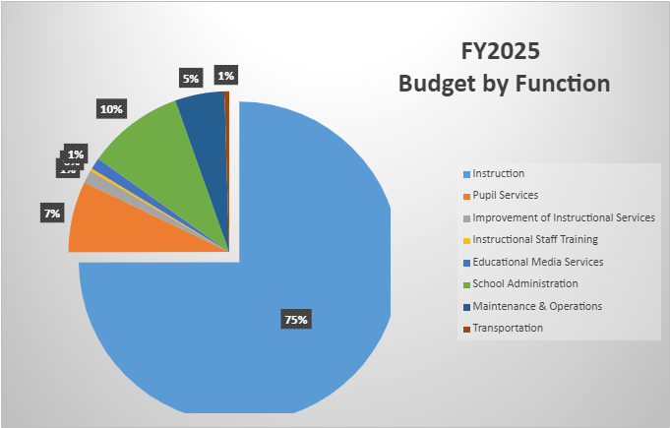
FY25 Budget by Function (Required)
*Based on Current Allocation of School Budget
Notes:
Explain the pie chart and allocations

Slide 16
Discussion of reserve and Holdback funds

Slide 17
Plan for FY25 Title I Holdback
$___(Insert Amount Here)___
Priorities | APS FIVE Focus Area | Strategies | Requests | Amount
Increase level of rigor and relevance (example- please remove) | Fostering Academic Excellence for All (example- please remove) | Implementation of guided reading training for all staff (example- please remove) | Purchase an additional Teacher (example- please remove) | $84, 134 (example- please remove)
EXAMPLE
Notes:
For the next few slides, I will show you how I have allocated the budget to support our strategic priorities.
Based on our strategic priorities and funds we received, here is a break-out of the priorities, which focus area it addresses, the strategies that will be implemented, the purchase request, which funding source was used and the amount.

Slide 18
Summary of position Changes to Support the Strategic Plan
CREATED | REMOVED
Social Studies (3) | Assistant Principal (1)
 | Instructional Coach (1)
 | Counselor (1)
 | Teachers (4)
 | Social Emotional Learning Coach (1)
 | SST Interventional Specialist
 | No Instructional Aide (2)
Summary of Changes
Duties of removed positions will be absorbed by staff who traditionally perform similar duties

Slide 19
Questions for the GO Team to Consider and Discuss
Are our school’s priorities (from your strategic plan) reflected in this budget?
Are new positions and/or resources included in the budget to address our major priorities?
Do we know (as a team) the plan to support implementation of these priorities beyond the budget (ex. What strategies will be implemented)?
What tradeoffs are being made in order to support these priorities?
How are district and cluster priorities reflected in our budget?
Cluster priorities- what staff, materials, etc. are dedicated to supporting our cluster’s priorities?
Signature programs- what staff, materials, etc. are dedicated to supporting our signature program?
Are there positions our school will share with another school, i.e. nurse, counselor?
Notes:
CHAIR - Our final task for today! Here are questions that we need to consider to ensure we have a good working draft budget. Let’s walk through them together.

Slide 20
Where We’re Going?
Our next meeting is the Budget Approval Meeting
What:
During this meeting we will review the budget, which should be updated based on feedback from the staffing conference, Associate Superintendents, and key leaders. After review, GO Teams will need to take action (i.e., vote) on the FY25 Budget.
Why:
Principals will present the final budget recommendations for GO Team approval.
When:
All approval meetings must be held after staffing conferences. Budgets must be approved by March 15th.

Slide 21
What’s Next?
February
HR Staffing Conferences (Late February)
March
Final GO Team Approval Meeting (AFTER your school’s Staffing Conference and BEFORE Friday, March 15th)
Notes:
In February, we will meet again to discuss how the school’s budget has been allocated to support the programmatic needs and FY23 key strategic priorities.
If think we need to continue our budget conversations, we will schedule additional meetings. My goal is to make sure your voices are reflected in our school’s budget.
I will also be meeting with my Associate Superintendent, program managers and other key leaders to go over our budget and to make sure the school is meeting the standards of service and appropriately staffing.
During the week of Feb. 24th -March 2nd , HR Staffing Conferences will be held. At this meeting, I will present my plan for staff utilization, resource distribution and plan for staffing implications.
We will need to approve the budget at the ________ meeting.

Slide 22
Thank you

